Slide 1
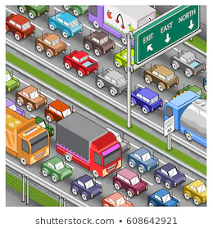
Colorado Car Accident Severity Prediction
Joanna Johnson

Slide 2
Introduction
Wouldn’t it be nice if there’s a system can tell you how bad the accident ahead of you is, so you can decide if you should stay on the same road or exit?

Slide 3
Data
US_Accidents > Colorado_Accidents (filter on state=‘CO’)
Covers February 2016 to June 2020 traffic events data
49,731 accident records
I used this dataset to build a machine learning model for live prediction of car accidents’ severity level (1-4) in terms of impact on traffic.

Slide 4
Features Selection
Duration_in_Hour
Interstate
Distance_mi
Crossing
Give_Way
Railway
Station
Stop
Traffic_Calming
Traffic_Signal

Slide 5
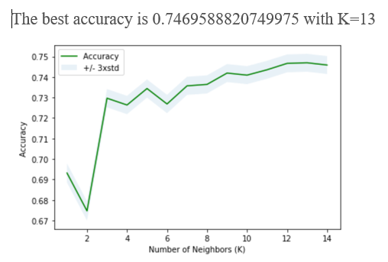
K-Nearest Neighbors

Slide 6
Decision Tree
Decision Tree’s accuracy is 0.7532924499849201

Slide 7
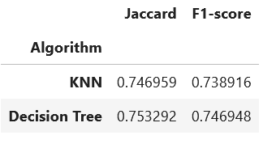
KNN vs Decision Tree

Slide 8
Discussion
Bigger dataset can help improving model’s accuracy
More attributes, such as # of lanes, construction, police on site, ambulance on site, etc can improve prediction
Missing TMC code

